Slide 1
Customer Activation and Retention Project
By: Arpan Biswas

Slide 2
Problem Statement
Customer satisfaction is one of the most important factors that guarantee the success of online store. Large number of customers are getting attracted towards the online shopping because e-stores offer them variety of services and products according to their preference.
Some home-grown small e-retailers struggling because of competition. The decision making by these e-tailers becomes very much important in terms of customer activation and retention.
Hence, there is requirement of research on the dynamics of the Indian online retail industry and coming out with the models for successful development of this industry.

Slide 3
Contd…
In this project, we have dataset of customer activation and retention. The primary objective of this study is to propose and analyse the online retail success model with emphasis on proving values to the customers.
This work proposes two online retail success models and analyse them with the data collected from online retail customers in India.

Slide 4
Data sources and formats
I get data from the Indian online shoppers. The work has focused upon customer satisfaction and purchase decisions.
This data set contains 269 records and 71 variables. All the variables are related to customers shopping feedback.

Slide 5
Problem Solving Approaches
Below is the method that we use in solve the issue and make the best model:
Data preparation
Data cleaning
Data analysis
Conclusion

Slide 6
Data preparation and cleaning
For cleaning or pre-processing the data we use some techniques which are described below:
We check null values and negative values present in the data, but there is no null value and negative value found in the dataset.

Slide 7
Assumptions used
This is a model used for the analysis-
Customers Retention model: This model includes two values hedonic values and utilitarian values. Based on hedonic and utilitarian values we conclude customer’s retention model or customers purchase intention.

Slide 8
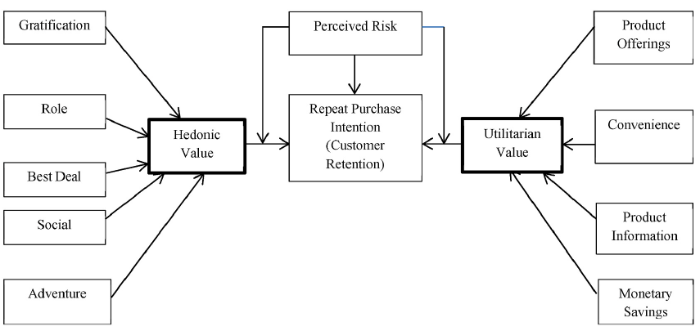
Contd…
Customers retention model

Slide 9
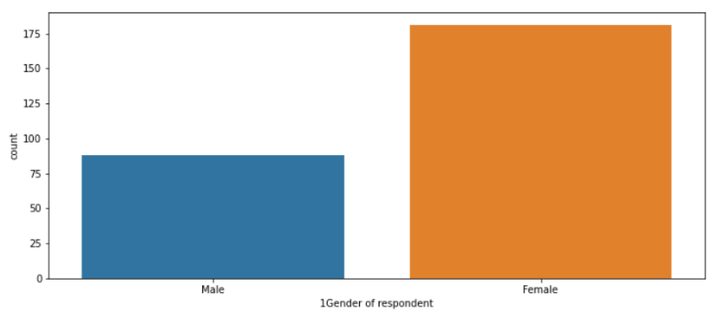
Data Analysis
Gender of the respondent showed that number of the female is higher than number of male.

Slide 10
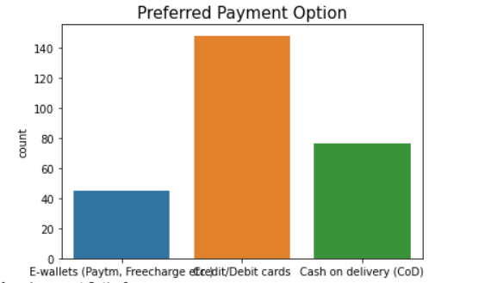
Contd…
From the plot we can see that, majority of the respondents pay their bills using debit or credit card, while least number of the respondents pay their bills using e-wallets like Paytm, Freecharge etc.

Slide 11
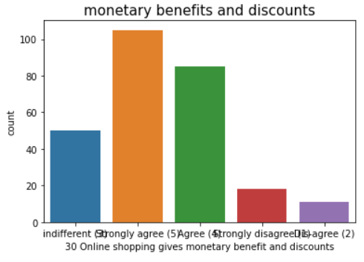
Contd…
Most of the respondents strongly agree that online shopping websites provide monetary benefit and discounts.
Monetary benefit is utilitarian value and it is one of the major reasons of shopping online is to get value for money, in other words, spend less on products thereby saving more money. This monetary benefit attracted more customers and increases customers repeat purchase intentions.

Slide 12
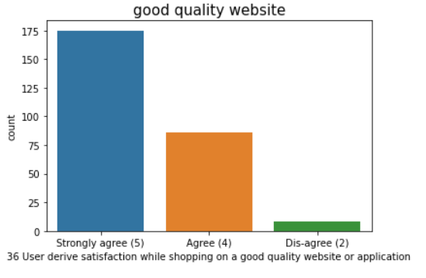
Contd…
From the plot we can see that, out of 269 respondents 133 respondents strongly agree that display quality information on website improves satisfaction, while 80 respondents agree on the same.
One of the basic responsibilities of an e-tailer is to ensure the availability of complete information on products being offered. Displaying high quality information on the website can stimulate an improved conversion rate as well as better customers’ satisfaction.

Slide 13
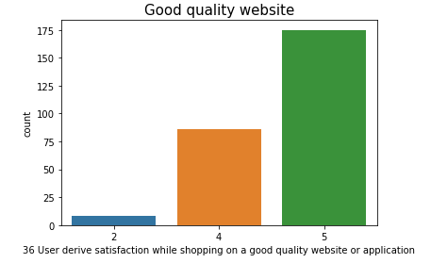
Contd…
From the plot we can see that, out of 269 respondents 175 respondents strongly agree that quality of website or application is good, while only 8 respondents dis-agree with good quality of website or application. (2=Dis-agree, 4=Agree, 5=Strongly agree)
Good quality website includes performance of the website, page load speed, ease of navigation between pages, appearance, website availability, and website layout.
These values affect the performance of the website and deciding satisfaction of the customers. When customers purchase a product from a website, functionality snags (for example, Website crash, interruption) may result in a poor customer user experience, while good quality websites positively impacts online customer satisfaction.

Slide 14
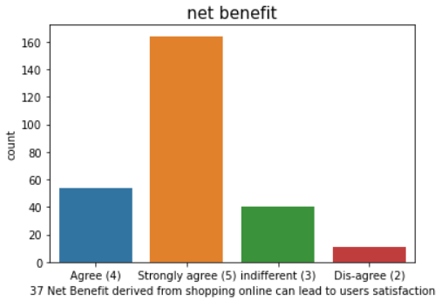
Contd…
Majority of the customer satisfied with net benefit while shopping online. for instance, money, time, effort, timely delivery, etc.
Net benefit is total benefits received when shopping online by customers, as against the costs (for example, effort, money and time). According to a research net benefit of shopping online includes both utilitarian value and hedonic values.

Slide 15
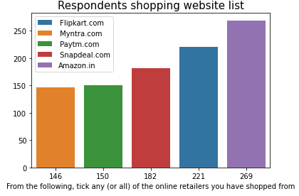
Contd…
From the plot we can see that, all 269 respondents use amazon for online shopping, while out of 269 respondents 146 respondents use myntra for shopping, which is least number among all categories. (Note: This plot is including those respondents, who use more than one website for shopping.)

Slide 16
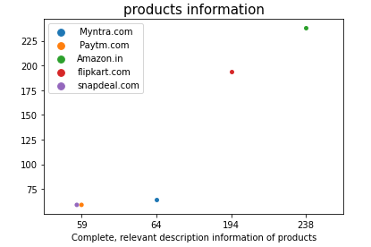
Contd…
From the swarm plot we can see that, out of 269 respondents 238 respondents say that amazon provide complete and relevant information of products, while out of 269 respondents only 59 respondents think that paytm and snapdeal provide complete and relevant information of products. (Note: This plot is include those respondents, who gave feedback for more than one website.)
The information provided by the online retailers has to be detailed enough to enhance the customer decision in making a purchase or not. This details information also attracts the customer for repeat purchase intention.

Slide 17
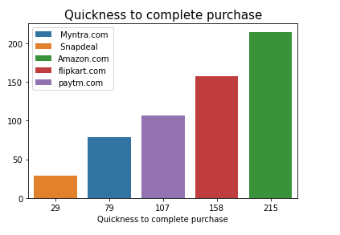
Contd…
From the plot we can see that, out of 269 respondents 215 say that amazon.com is quick to complete purchase, which is highest among all categories. Flipkart.com is second highest website for quick to complete purchase. (Note: Plot is including those respondents, who gave feedback for more than one website.)

Slide 18
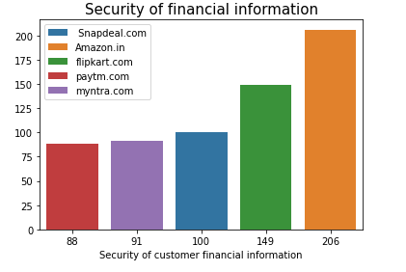
Contd…
Out of 269 respondents 206 respondents say that amazon provide best security of customer financial information, while 149 respondents say that flipkart provide best security of customer financial information. Security of financial information affects customers repurchase intention. (Note: plot is including those respondents, who gave feedback for more than one website.)

Slide 19
Conclusion
To run an effective web-based retail sore, accentuation should be given to the factors important for client fulfilment. For example, items data, framework and administration characteristics, net advantages, and so forth By and by, e-rears are needed to incorporate different advantages also to make worth to the client. From the examination we can say that the nature of framework, data, openness, security, and convenience are expected to speak to the buyer's utilitarian qualities. On the other hand, to speak to the gluttonous upsides of the customer, the e-store should consolidate components that would offer worth to the joy looking for conduct of clients; for instance: experience, satisfaction, job shopping and so forth.

Slide 20
Contd…
Online retailers should zero in on the data quality and framework nature of the internet-based retail sites to upgrade consumer loyalty, which thus will prompt repurchase choice. Both the utilitarian and decadent qualities prompted consumer loyalty and extensively animate their repurchase aim, prompting reliability.

Slide 21
Thanks

